Slide 1

Opportunities to Improve the User Experience of 8tracks
Group 5: Ruyun Chen, Jannik Haas, Raymond Magambo, Hamidullah Sakhi, Arushi Vyas
Group 1: Weizhen Qin, Ruyun Chen, Kai Feng, Bijun Zhang
Group 1: Ruyun Chen, Kai Feng, Weizhen Qin, Bijun Zhang

Slide 2

Content
1
Problem Description
2
Database Design
3
User Interface
4
Technical Documentation & Limitations
Notes:
For your convinence, this is a table of contents of our presentation.

Slide 3

01
Problem Description

Slide 4

Problem Description
Overview of accounts and memberships
Membership Options
Employees
Merchandise
Notes:
We have come with the idea of business problem which would be focused on idea of fitness and we would call it”Fitness studio”.
We have included variety of different class options , membership options to meet the diverse customer needs. Also we have come with the retail merchandise options by stocking up and selling T-shirts, water bottles, sweatshirts, etc. We also need to keep the track of employee which are people who sell member and the inscrutor.

Slide 5





Reports
Revenue
Class Enrollment
Membership Sales
Retail Sales
Employee Performance

Slide 6
02
Database Design
Notes:
Talk about how to use database implement it and relationships of ERD ( based on customers)

Slide 7
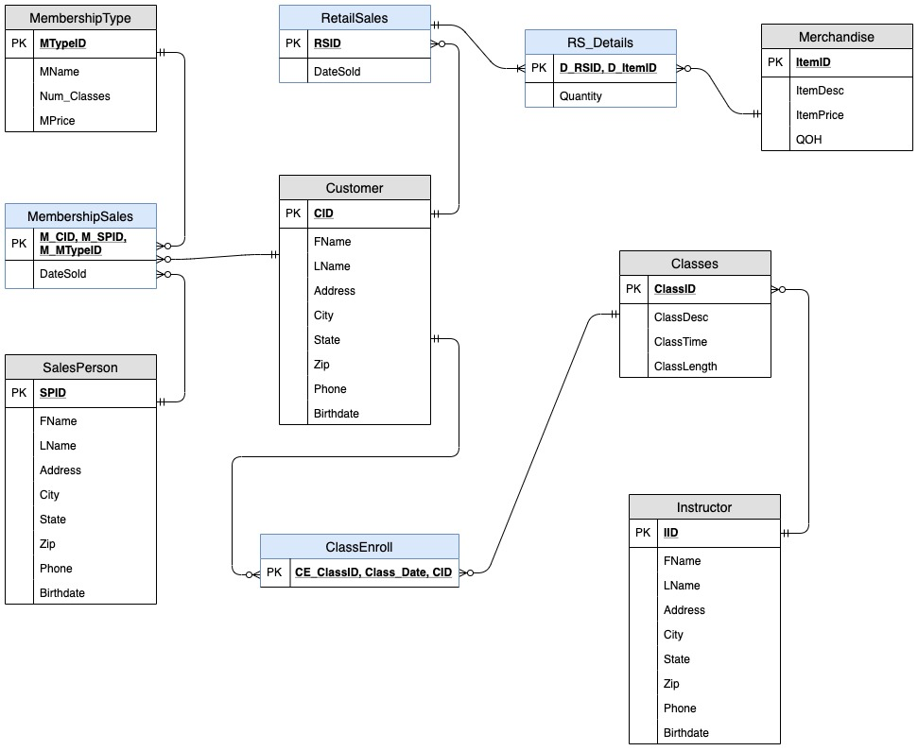
ERD Diagram

Slide 8
03
User Interface

Slide 9
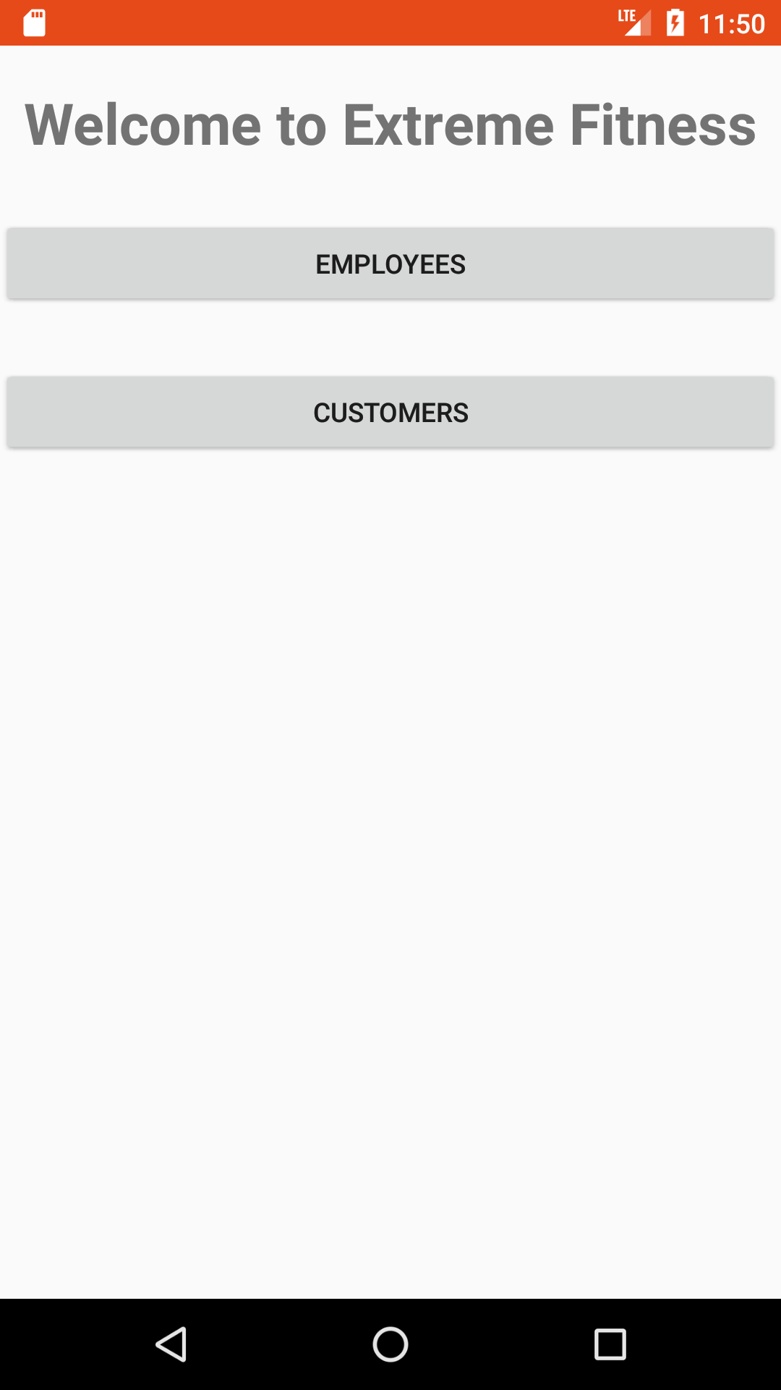
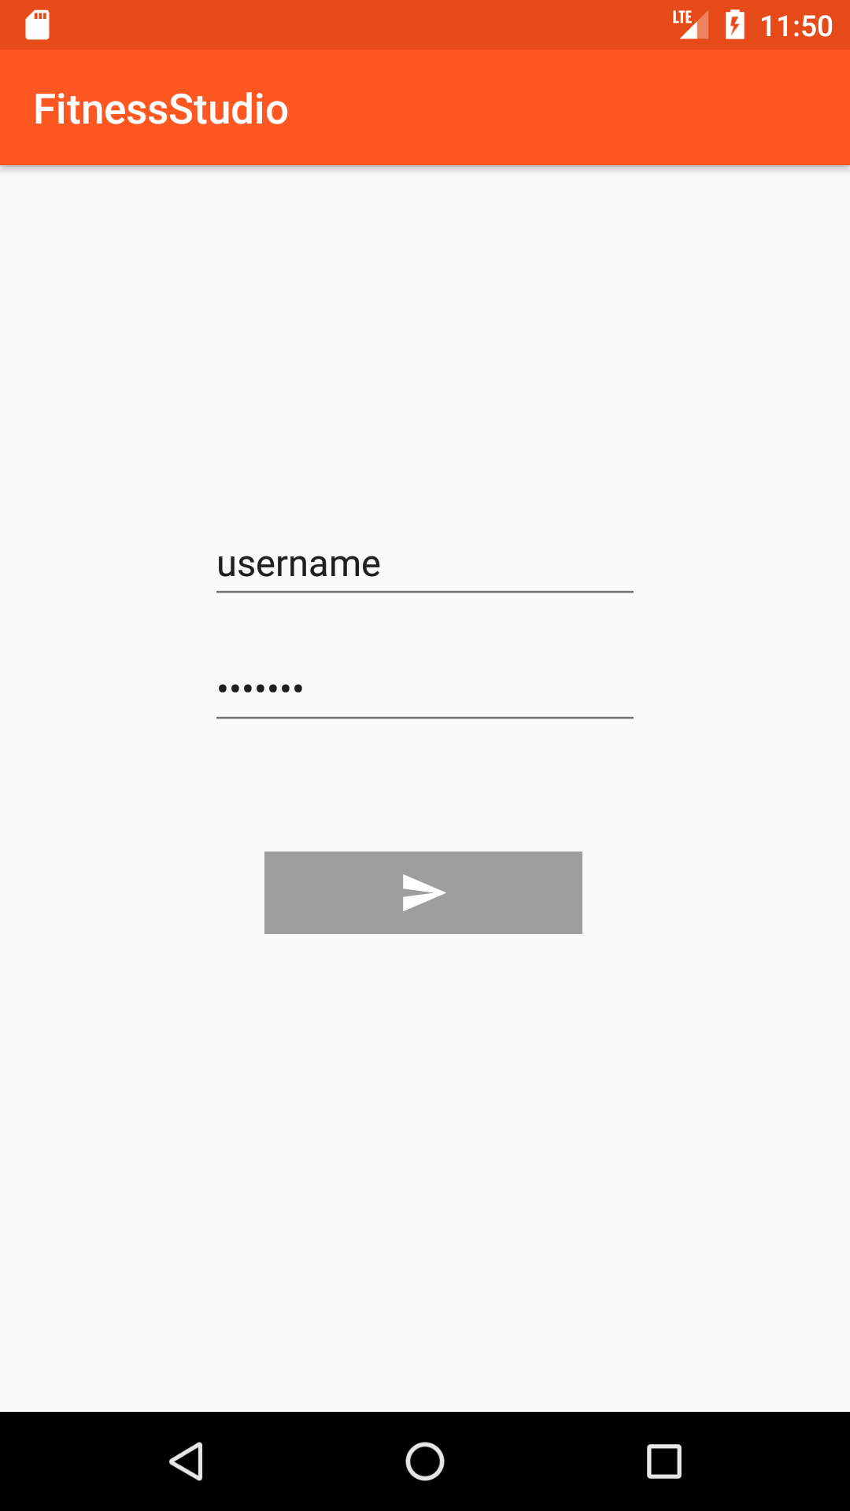
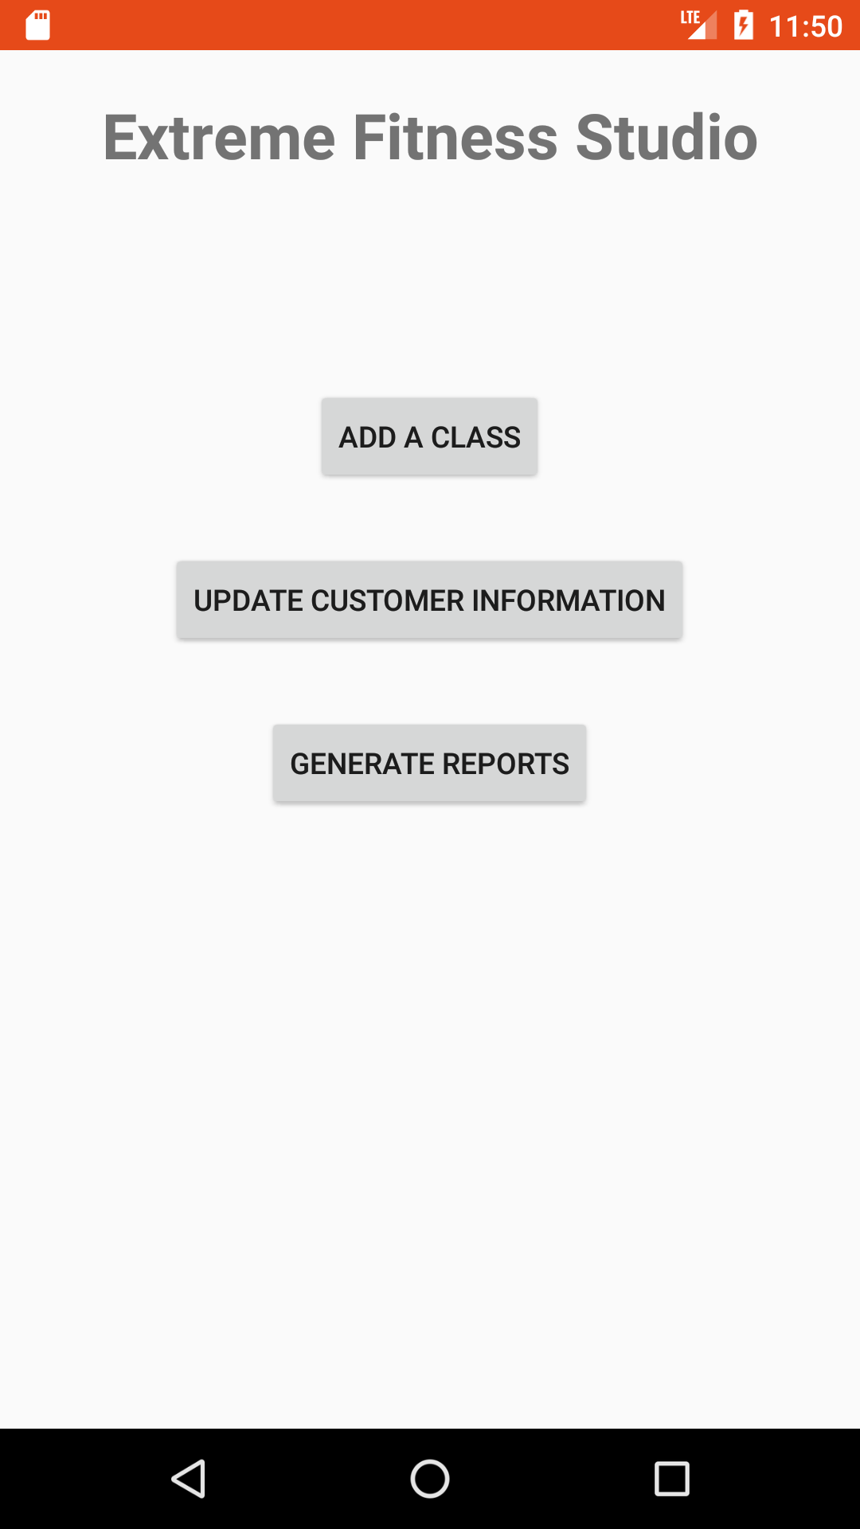

Slide 10
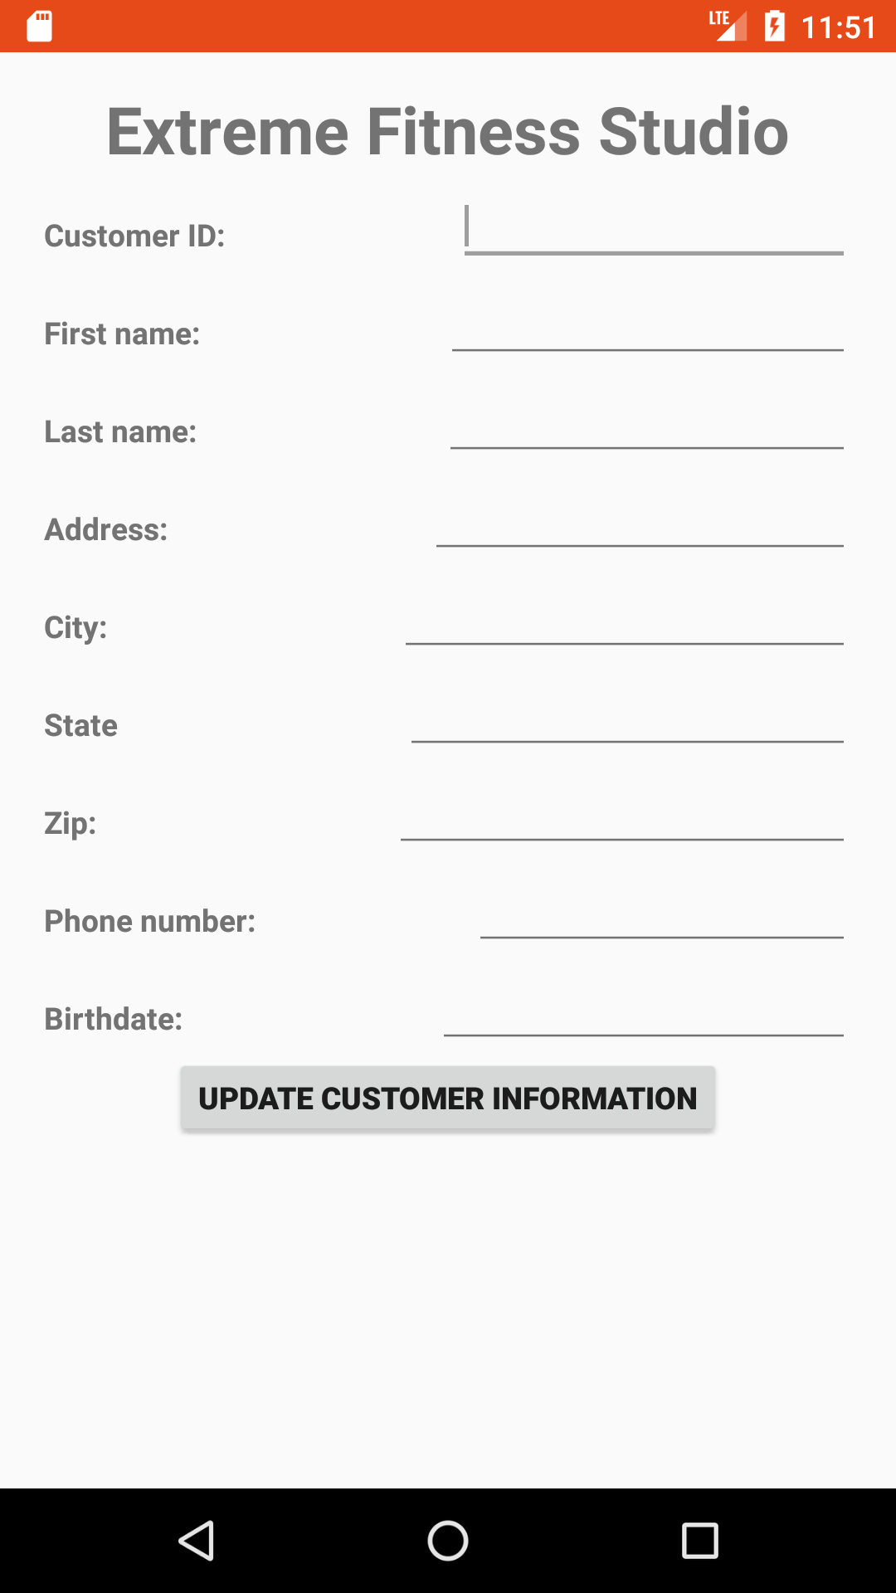
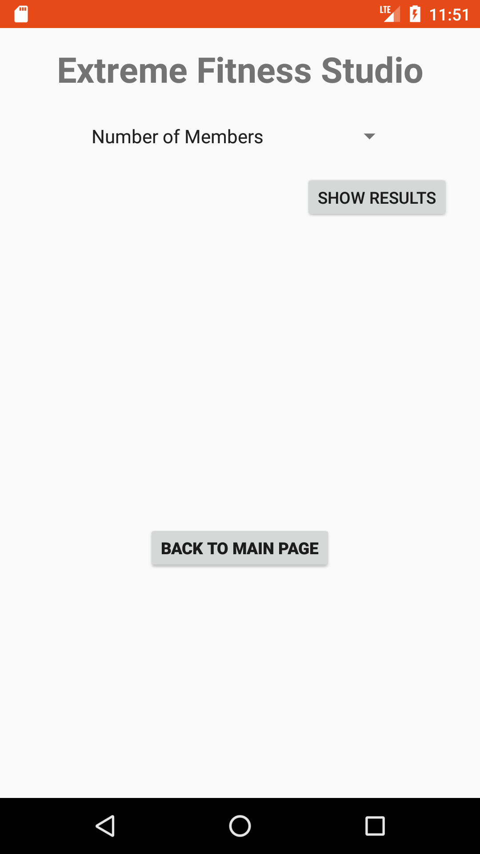
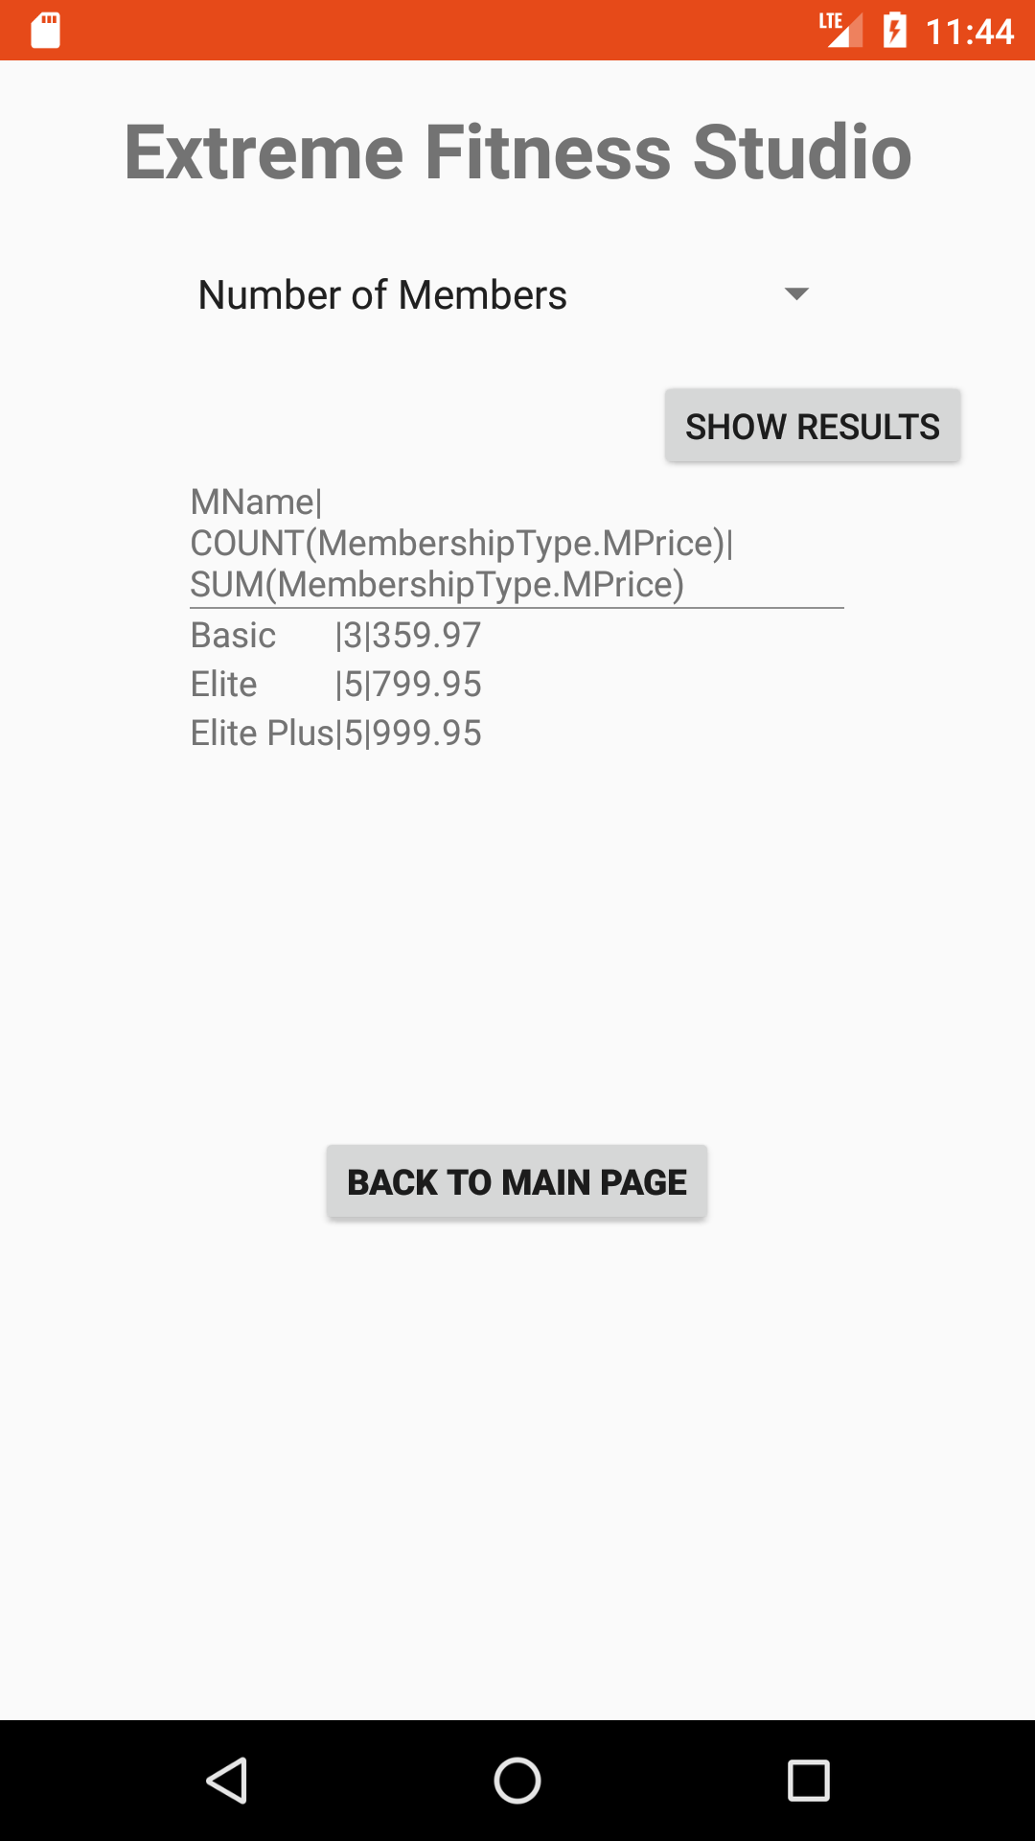
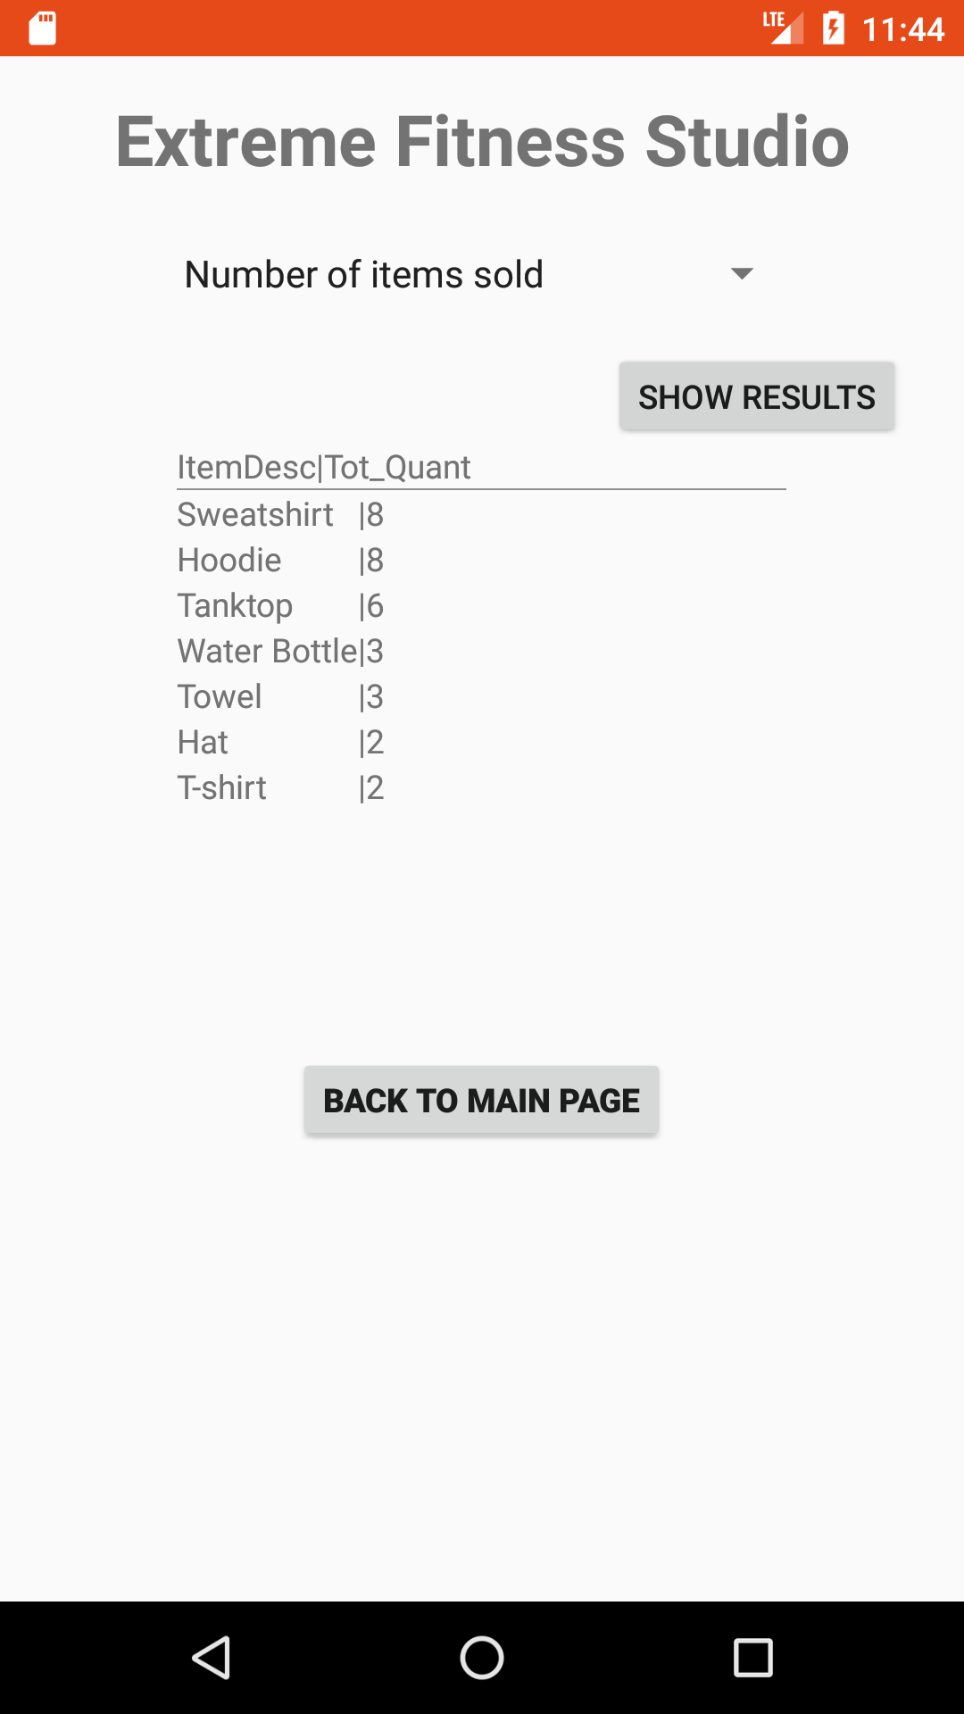
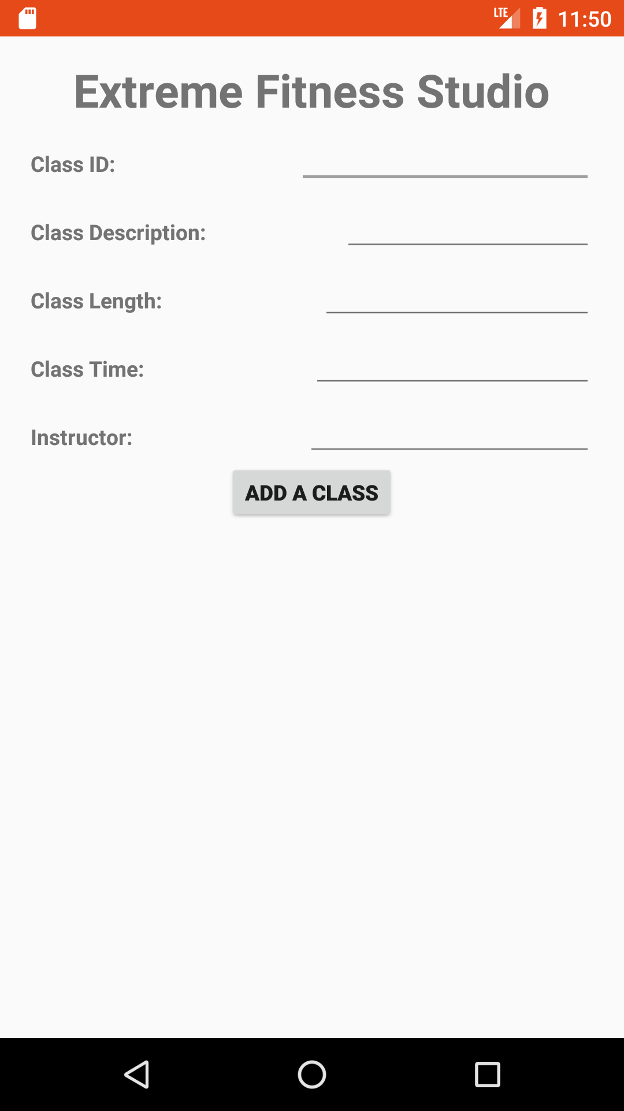
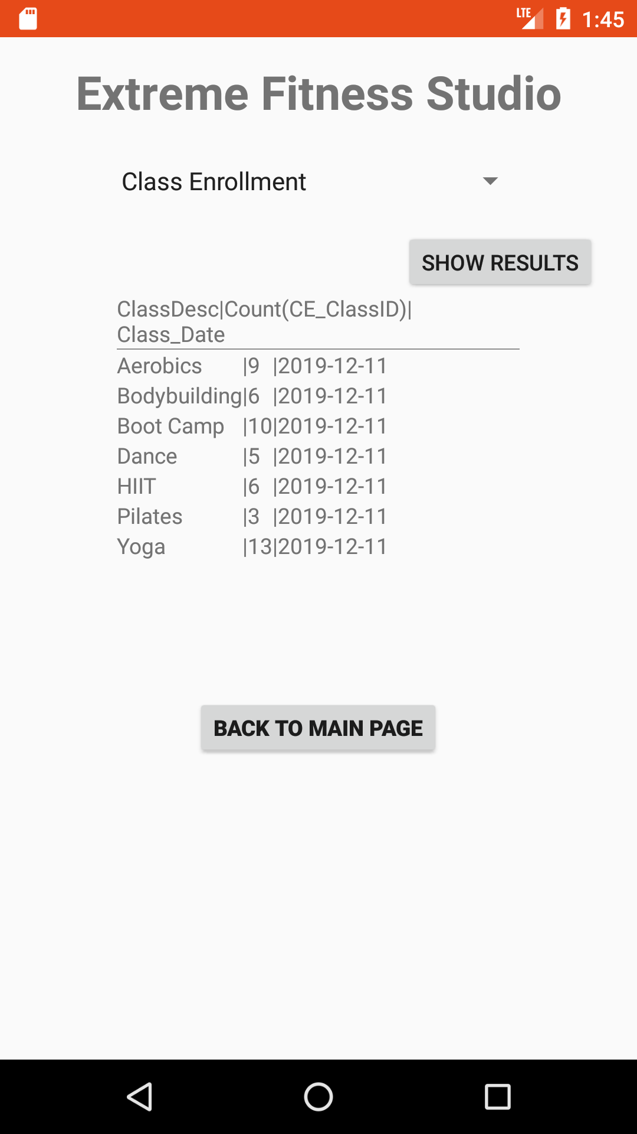

Slide 11
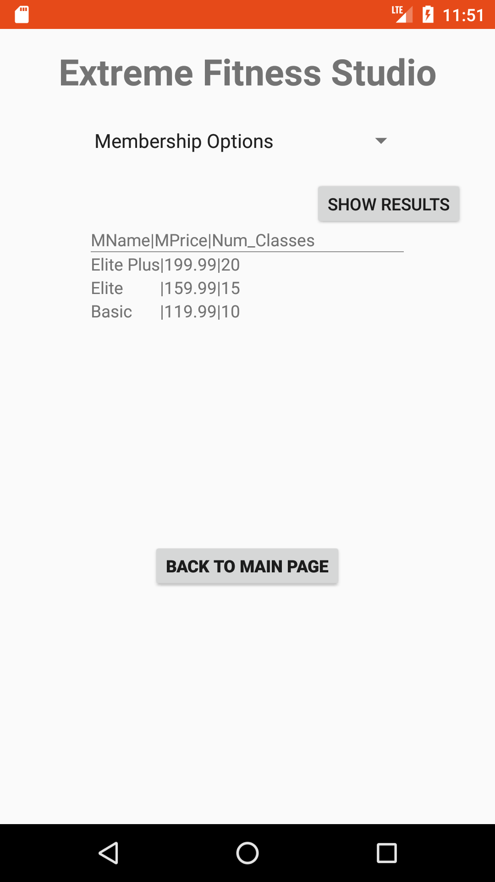
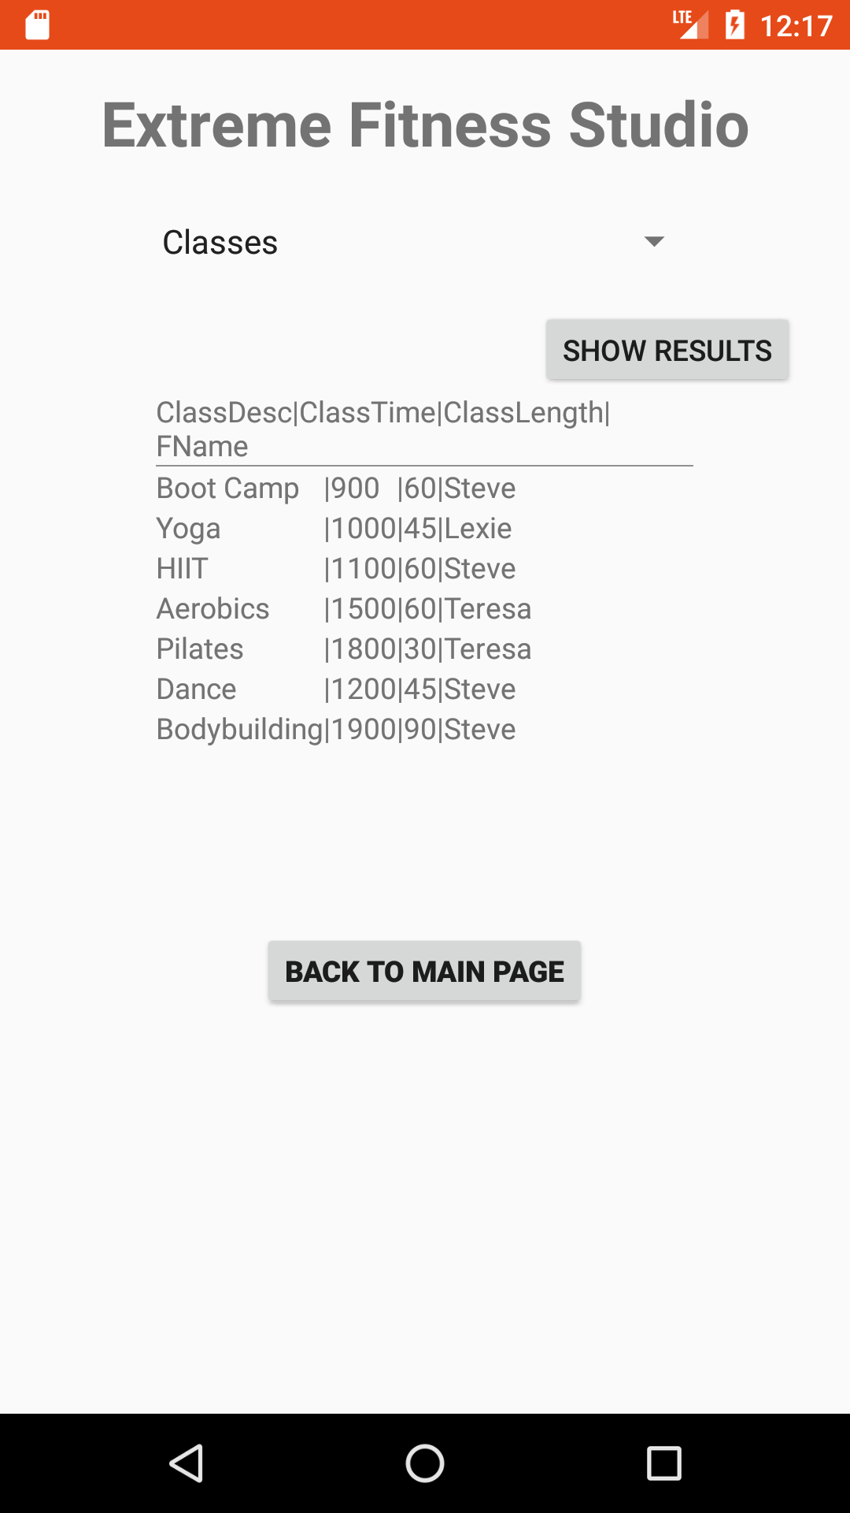
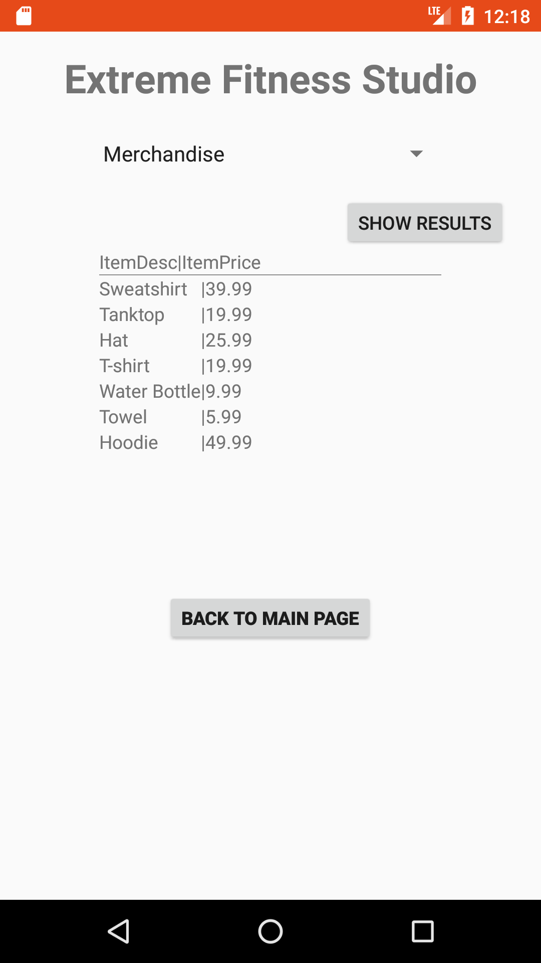

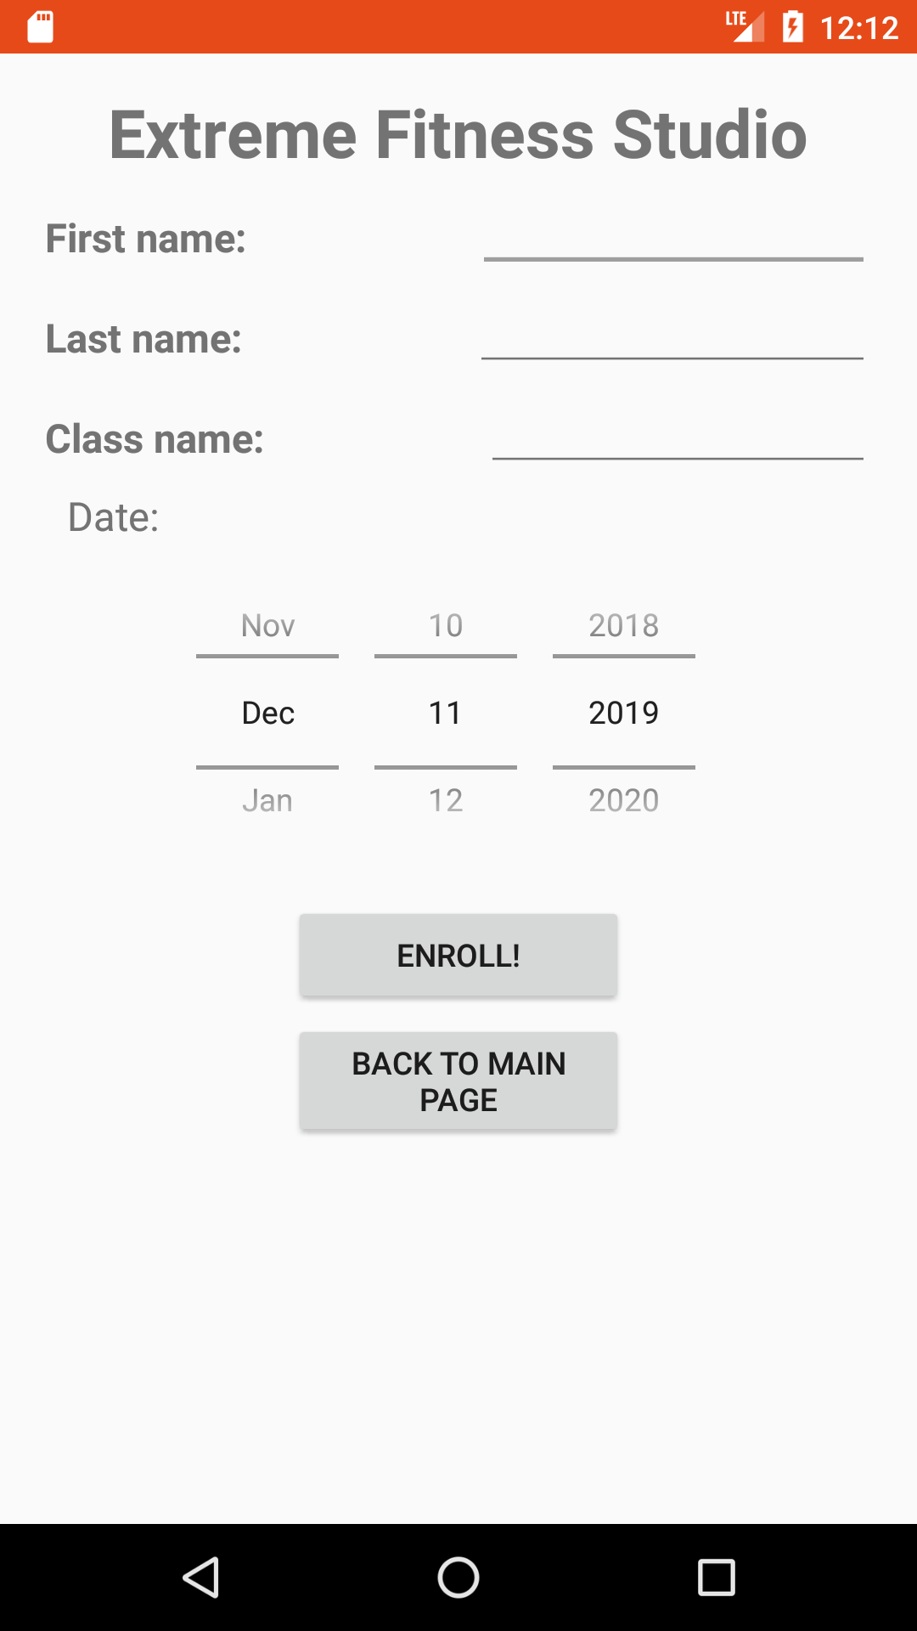
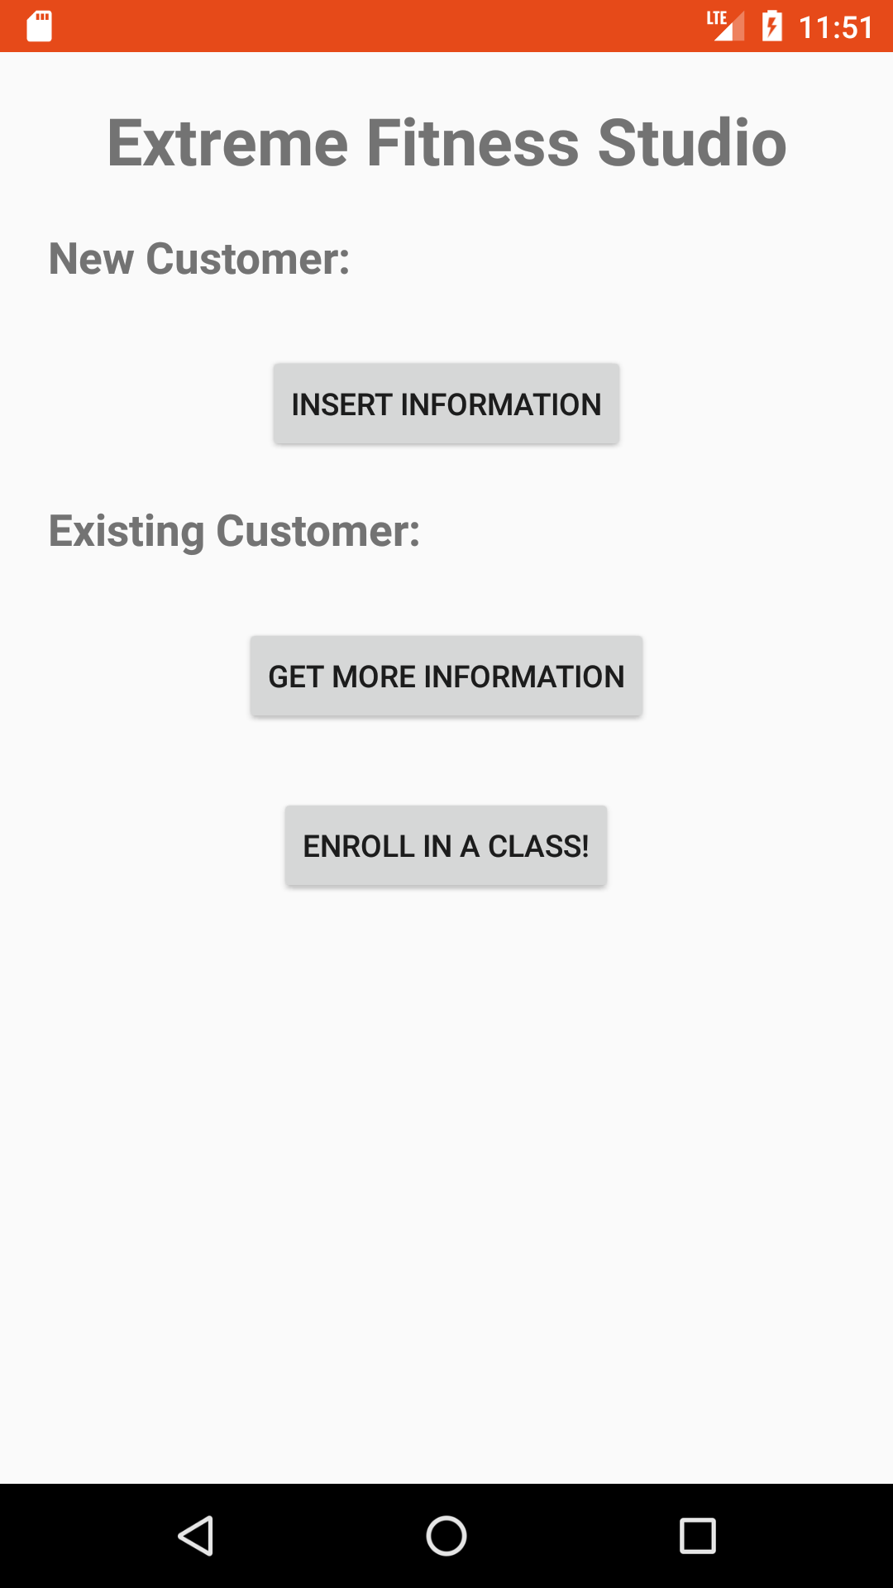
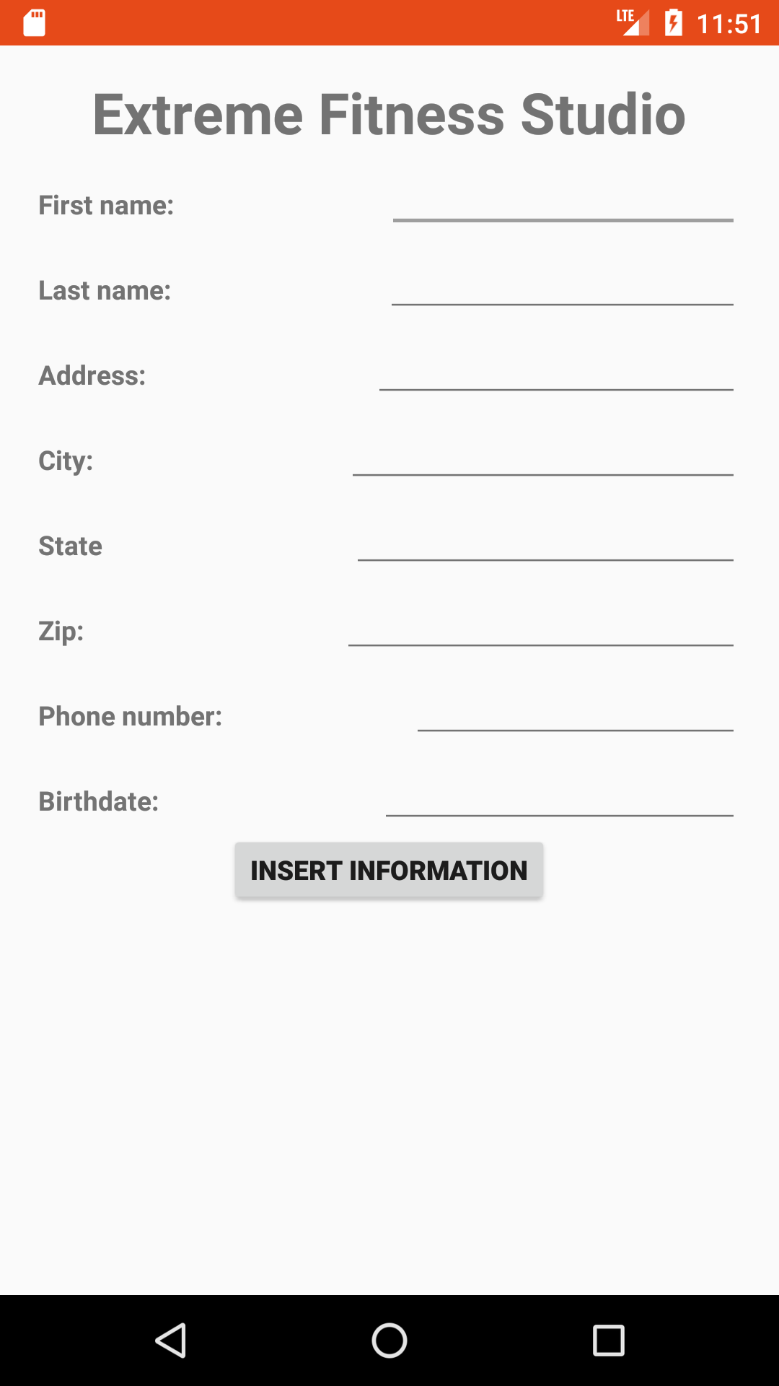

Slide 12
04
Technical Documentation
&
Limitations

Slide 13

Database Total Estimates
Current | 31,046 bytes
Estimated in 5 years | 195,681 bytes

Slide 14



Backup and Security features
Safety options:
Authorizations + restricted access
Verification:
Future improvements:
Online centralized server connection + other means of security
Login usernames & passwords

Slide 15

Potential Data Quality Problems
Features implemented: Constraints and Limitations
Current limitations: Data discrepancy and data reliability problem

Slide 16
Q & A
Thank you

